Slide 1
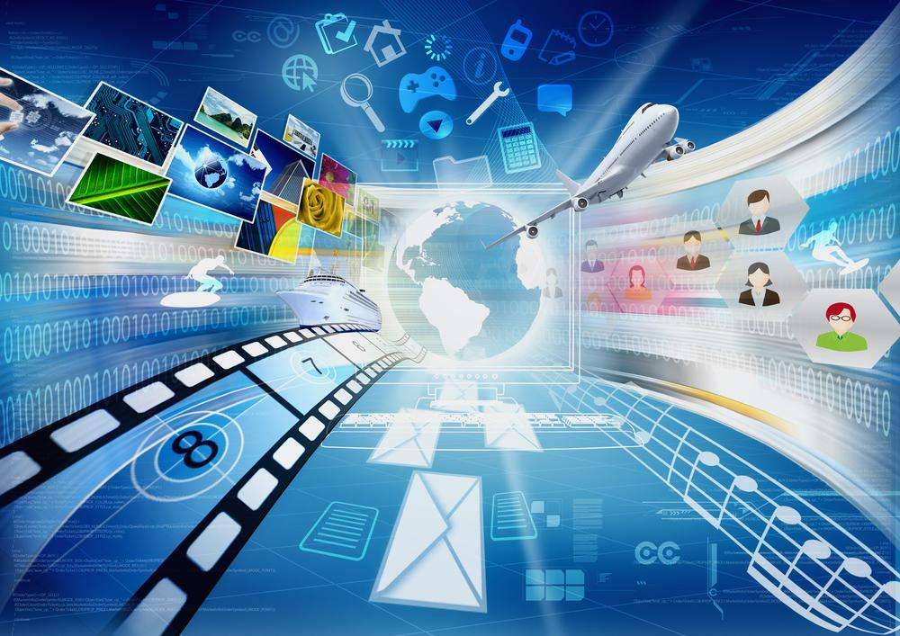
Assessment 2
MakepeXoliswa
This Photo by Unknown Author is licensed under CC BY-SA

Slide 2
What is the internet of things?
The internet of things describes physical objects that are enable added with sensors , processing ability , software and other technologies that connect and exchange data with other devices and systems over the internet or other communications networks.
When it comes to IoT , there is a lot to learn.
But id doesn’t have to be so hard.
How does IoT work?

Slide 3
What is the history of Internet of things ?
The history of the internet has its origin in information theory and the efforts to build and interconnect computer networks that arose from research and development in the United States and involved international collaboration , particularly with researches in the United Kingdom and France.

Slide 4
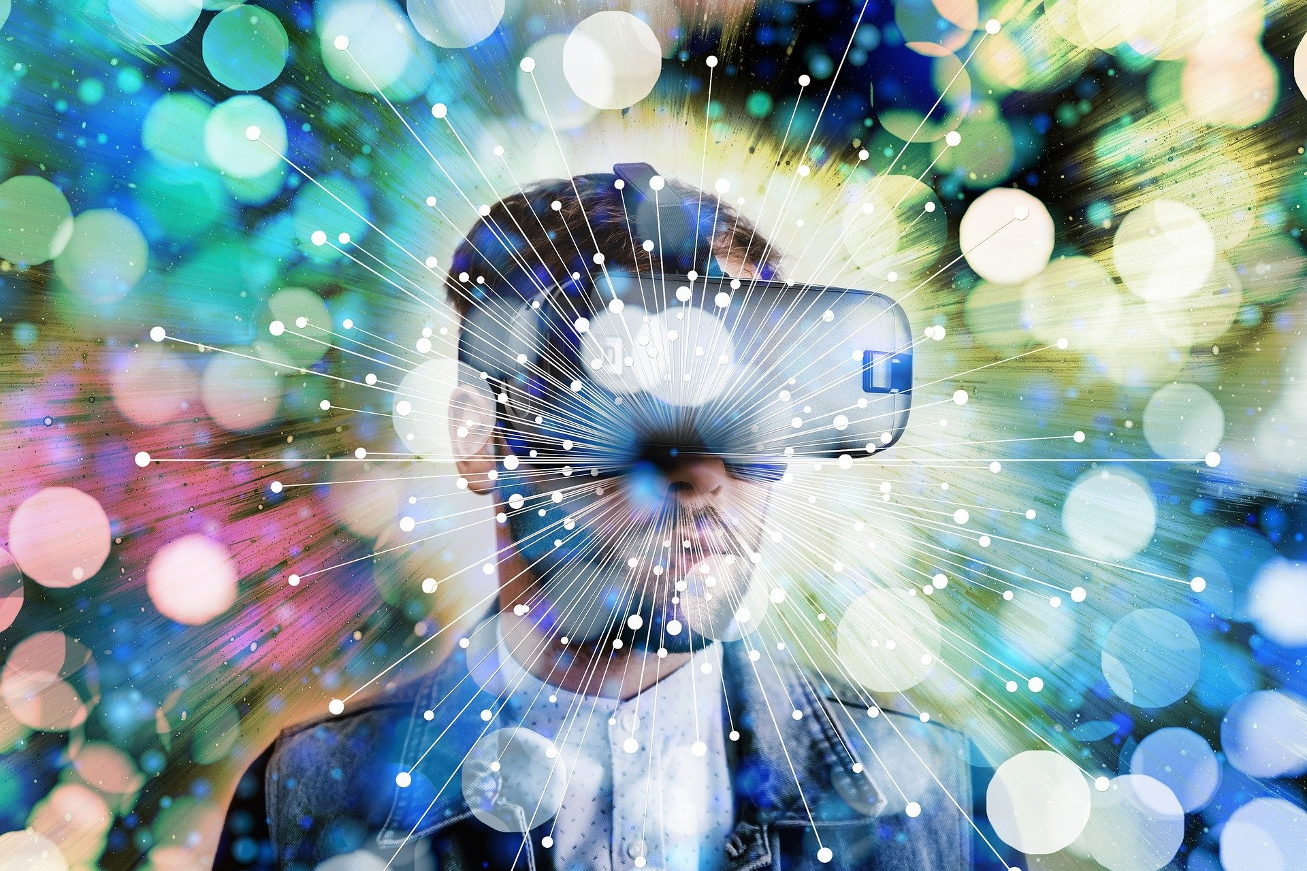
What does the technologies enable IoT ?
Internet of thigs wearables enable people to better understand their own health and allow physicians to remotely monitor patients.
This technology also enables companies to track the health and safety of their employees , which is especially useful for workers employed in hazardous conditions

Slide 5
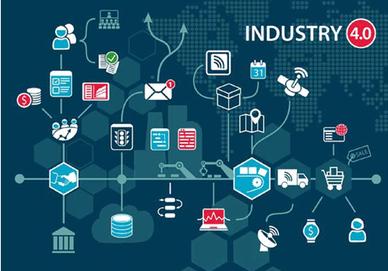
What is its impact ?
Positive
Negative
Impact on daily life style
Learning new things
Access to information
Education
Entertainment
Communication is massive as well
Connection.. The internet connect (almost) the entire world
Impact on environment
Impact on industry sector
Impact on Traffic management and control
Lack of sleep
ADHD
Obesity
Learning barriers
Cyberbullying
Loss of privacy
Decreased communication and intimacy
This Photo by Unknown Author is licensed under CC BY

Slide 6
What is its impact going to be in the future
The future of IoT has the potential to be limitless.
Advances to be industrial internet will be accelerated through increased network agility , integrated artificial intelligence (AI) and the capacity to deploy , automate , orchestrate and secure diverse use cases at hyperscale.
They are concerned that we will see increase in stress , anxiety , and depression as digital lives expand.
Meanwhile , there will be less face to face interaction , increased in actively , poor in person communication skills, and an overall district among people

Slide 7
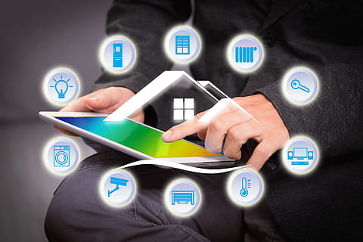
In conclusion
Internet is the best thing , it also connect us with our long relatives.
It also help us doing our school work , search everything
There is also social life now everything we see there.

